Slide 1
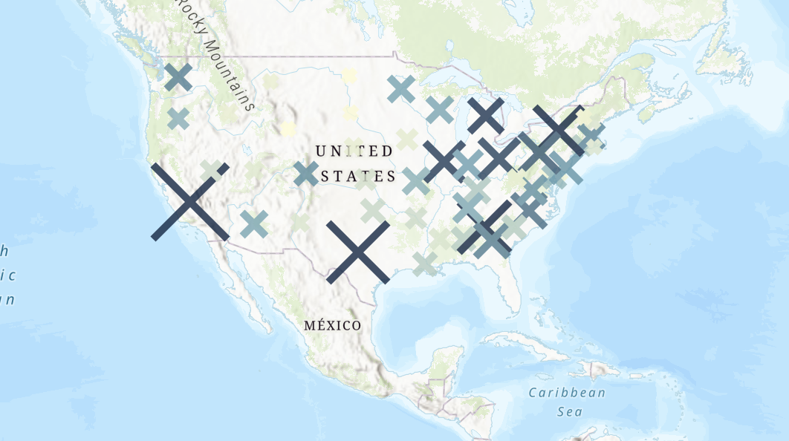
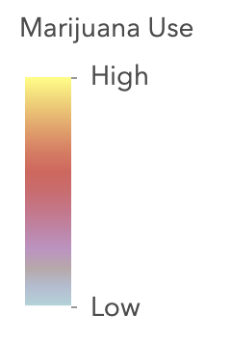
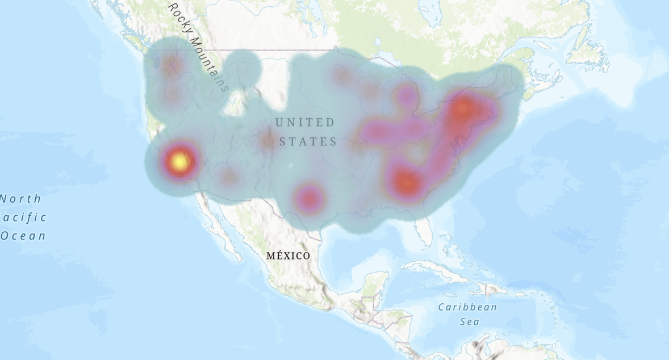
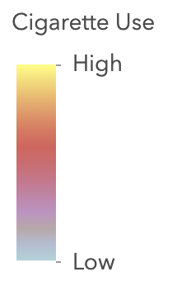
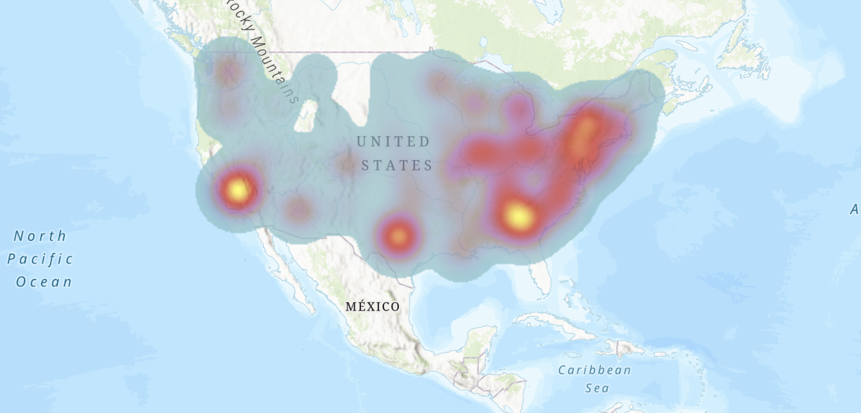
Assessing the Country-Wide Marijuana and Cigarette Use (2008-2007), and the Correlation Between the Two
Introduction
Results
This study pushes to identify the correlation between individuals that consume marijuana and individuals who smoke cigarettes. These two drug types are looked down upon and have been seen to go hand and hand throughout society (Crane, 2021). Usage has been seen to deal with habituation and not so much due to addictive properties in the substance (Morean, 2021). Here we strive to show that not all individuals that smoke weed, also smoke cigarettes. Overall there are significantly more cigarette smokers than there are marijuana consumers
California (1,998) and New York (1,130) have the highest values for marijuana consumption across all USA states. For Cigarette consumption, California (5,794) and Texas (4,465) have the highest values. The lowest values for marijuana consumption are located in Wyoming (24) and North Dakota (27). The lowest values for cigarette consumption are located in Wyoming (119) and Vermont (120). California has the highest levels of consumption for both marijuana and cigarettes. Wyoming has the lowest levels of consumption for both marijuana and cigarettes
Figure 1
Data
Conclusions
The exact data gathered for this research solely originated from The US Census Bureau. The file, “Estimated use of selected drugs by state” was utilized and manipulated for this project. All US stated were listed on the file as well as the percent values for drug consumption in each state. The file had values for both types of drugs; marijuana and cigarettes. Also, the survey taken for these values was conduced in 2007-2008.
Overall, there is no concrete evidence which clearly shows that smoking marijuana leads to the usage of cigarettes and vice versa (Morean, 2021). Most cases of excessive usage are due to habituation and frequency of using the substance. Although we can see some relation between the two substances in the location of the maximum and minimum values. California has the highest values and Wyoming has the lowest values for usage of both drugs across the USA. My research shows that there are far more cigarette users than marijuana consumers (Crane, 2021). . In Figure 3 there are much more yellow zones than in Figure 2, indicating high levels of cigarette usage.
Figure 2
Methods
Following the steps for when we conducted an assignment based on geocoding, the data for drug use was used. Three Separate tables were created for each of the figures seen to the right. All USA states were used in the creation of all tables. All states were paired with; Marijuana & Cigarette consumption, Solely Marijuana Consumption, or solely cigarette consumption. ArcGIS.Com was used to create each map (Figures 1,2,&3) and all tables were downloaded as Comma-Separated Values (CSV).
Figure 3
Bibliography
Author, Contributors:
KJ Herwig, Prof. Lisa Jordan
March 10th, 2021
ArcGIS Pro, 2021. esri.
Bureau, U. C., 2011. U.S. Substance Abuse and Mental Health Services Administration, National
Survey on Drug Use and Health, 2007 and 2008.
Crane, N. A., Langenecker, S. A. and Mermelstein, R. J. (2021) ‘Risk factors for alcohol, marijuana,
and cigarette polysubstance use during adolescence and young adulthood: A 7-year
longitudinal study of youth at high risk for smoking escalation’, Addictive Behaviors.
doi:10.1016/j.addbeh.2021.106944.
Morean, M. E. et al. (2018) ‘The Self-Report Habit Index: Assessing habitual marijuana, alcohol, e-
cigarette, and cigarette use’, Drug and Alcohol Dependence, 186, pp. 207–214.
doi:10.1016/j.drugalcdep.2018.01.014.
Figure 1 Shows marijuana use (Indicated by the color gradient) as well as cigarette use (Indicated by the size of the x) across all states in the USA
Figure 2 Only shows a heat map of Marijuana use Throughout all states in the USA (More use = More Yellow, Less use = More gray)
Figure 3 Only shows a heat map of cigarette use throughout all states in the USA (More use = More Yellow, Less use = More gray)

